Slide 1
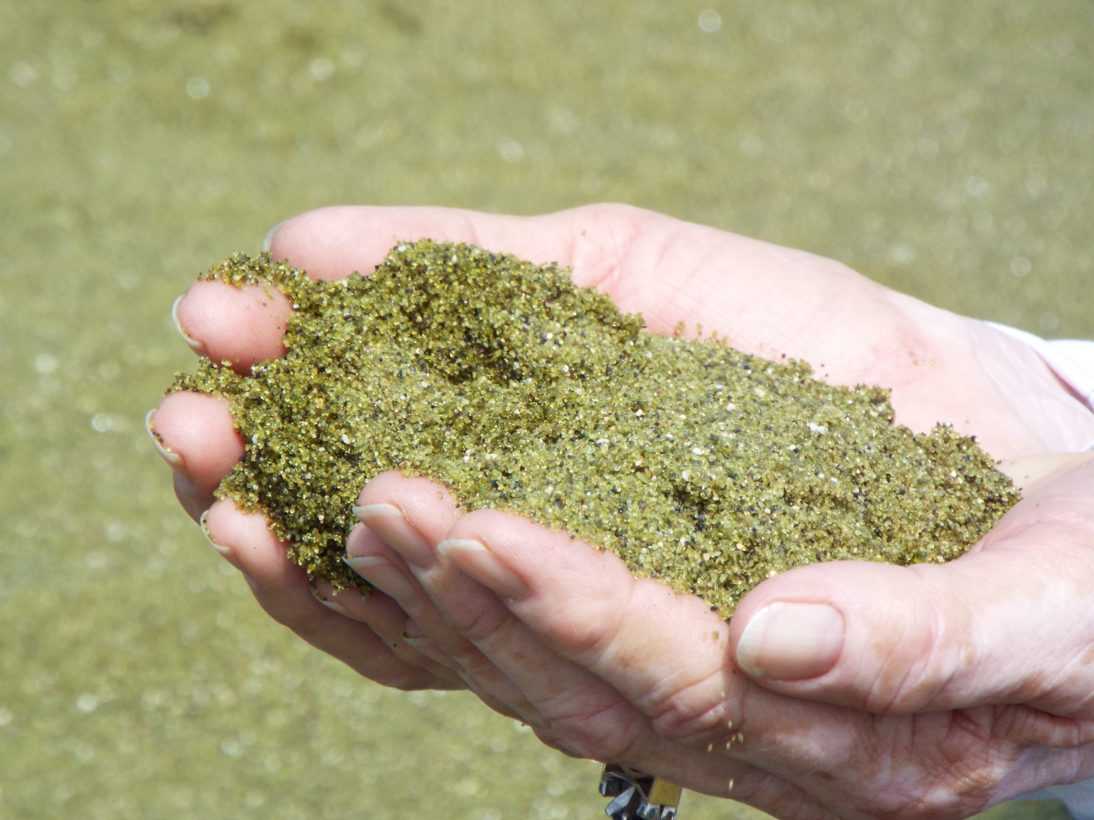
Ecological modeling
of olivine dissolution in coastal systems – Luna Geerts

Slide 2
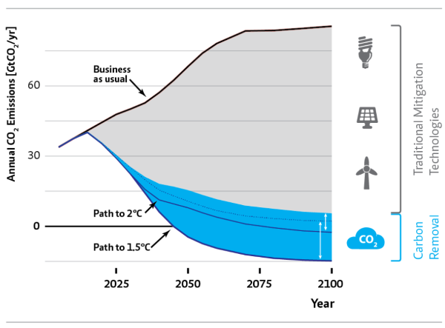
Positioning
Meeting Paris climate goals (1.5 – 2 °C warming) implies:
Reducing emissions i.e. “Mitigation”
Active removal
Via employment of Negative emission technologies (NETs)

Slide 3
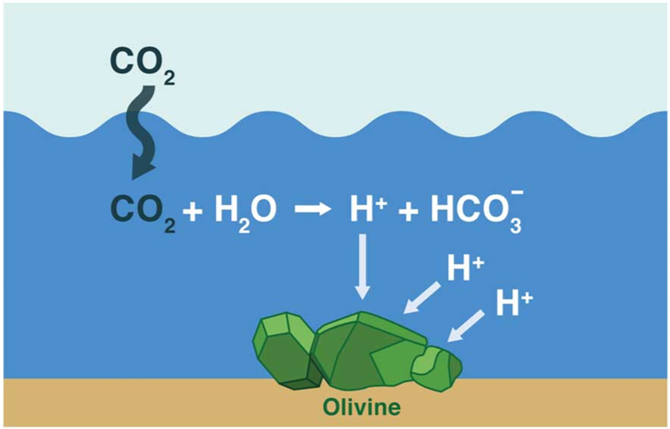
Enhanced Silicate weathering in coastal systems as a NET
Weathering of silicates cause drawdown of CO₂
Olivine is the fastest, readily available silicate mineral
However weathering is a really slow process!
How slow?
Let’s model it!
Notes:
As you know the increase of CO2 in the atmosphere acidifies our waters through the acid base dissociation reactions. silicate weathering reduces the CO2 in the atmosphere through this exact process by increasing the pH, thus drawing in more CO2. The fastest most readily available mineral is olivine . But whilst it is one the fastest, weathering as a process is still extremely slow!

Slide 4
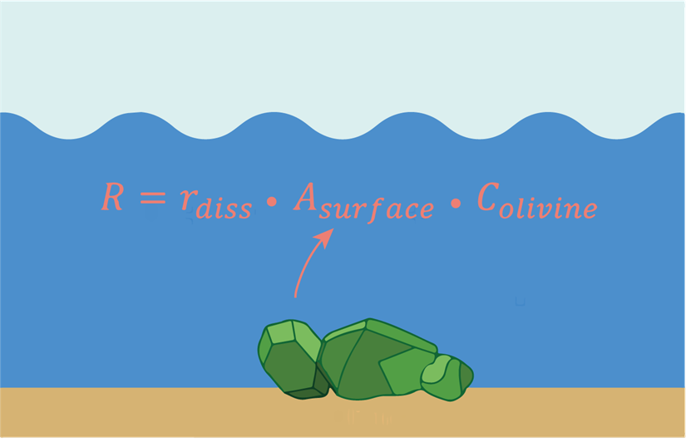
Formal question and model
How long does it take for e.g. 10 grams of olivine to dissolve fully?
One reaction/equation
Many parameters at play…
Notes:
The formal question we want to solve with our model is thus, how long does it take to dissolve e.g. 10 grams of olivine in a coastal system?
For this we only need one equation namely the reaction rate, no olivine is continuously added nor is any of the olivine washed away. The reaction rate is determined by the dissolution speed of olivine (which is in units mol m^-2 seconds) the surface area and the concentration olivine.

Slide 5
Parameters that drive olivine dissolution/weathering
pH
Temperature
Surface area
Concentration Olivine
Concentration CO₂ in atmosphere and sea
Secondary reactions
Current (pH 8.3) and acidified ocean (pH 7.8) scenario
An “Hawaii” and “Ostende” application scenario
Different starting grain sizes
10 grams per m² seafloor
Assumed to have no effect
Assumed to not occur
Notes:
The ingredients which play a crucial role in olivine weathering
These are the main elements which drive olivine dissolution rates. pH affects dissolution since the dissolution reaction involves H+, temperature speeds up reactions in general. The surface area of the olivine grain determines how much of the grain is exposed to react with the surrounding seawater and thus can dissolve. Concentration of olivine matters since saturation of the dissolved products can occur
Saturation of CO2 in atmosphere…
Secondary reactions (other than the one we saw which dissolves olivine)

Slide 6
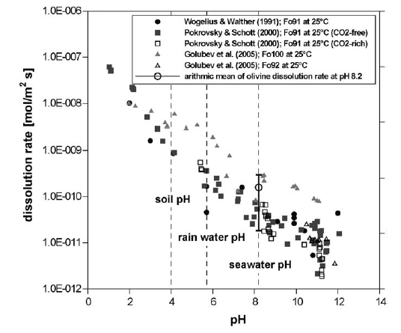
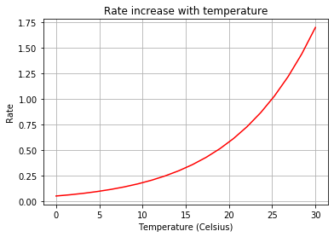
Dissolution rate depends on mainly…
pH (with large uncertainties)
Temperature
Notes:
The dissolution rate depends on the pH (note the large uncertainty! More on that later) which is derived from a paper (Hangx and Spiers (left)) the temperature effect is plotted on the right given by the Ahrrenius equation, which shows that assuming that we get half the rate of the one found at 25 degrees when we are at roughly 20 degrees

Slide 7
Total surface area
Total surface area depends on:
Amount of olivine (e.g. 10 grams)
Bulk density
Initial grain size
Find total volume
Surface area 1 grain + Volume 1 grain
With these we can find # grains and total surface area!

Slide 8
Surface area of shrinking grain
But surface area is not constant but changes during dissolution!
Thus at each timepoint calculate:
Loss in total mass per time step
Loss in total volume per time step
Divide total volume loss over all grains
Each grain now shrinks per time step

Slide 9
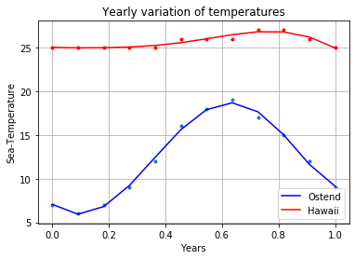
Temperature in Ostend and Hawaii
We only got monthly point data, but the model requires a function!
Approximate monthly temperature data with a polynomial fit
Notes:
There was an issue though, we only have monthly sea temperature data but our model needs a function to operate! This is because in the timesteps taken by our model we end up at a timepoint 1.2 months for example which has no measurement value.

Slide 10
Polynomial temperature fit
Points indicate measurements
Line is the fit to the points
Notes:
Dots are the measurements and the line is my fitted polynomial to it, as seen Ostends water is much colder whilst Hawaii is a nice warm, comfortable 25 degrees. Plotting this out made me realize how badly I want to go swimming in Hawaii one day –JOKE GOING HAWAII-

Slide 11
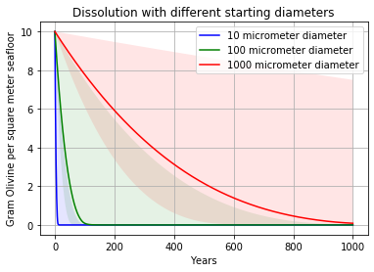
Model results – Starting diameter
The starting diameter has a large effect!
For fast effect (at 2050 and before end of century)
We need a grain size of between 10 and 100 micrometer
Notes:
We see tat the starting diameter has a very big effect not surprising as this increases the surface area by a lot!
Second we see that if we want to have a noticeable effect of olivine weathering on “relevant timescales” i.e. by 2050 and before the end of the century we need to go for a diameter between 100 and 10 micrometer diameter. (but do note that the smaller the grain, the more emissions we produce to mill them!.
Whilst the grain size has a large effect, the uncertainty regarding dissolution rates at a seawater pH are enormous…
-> compliant with the findings in literature ☺

Slide 12
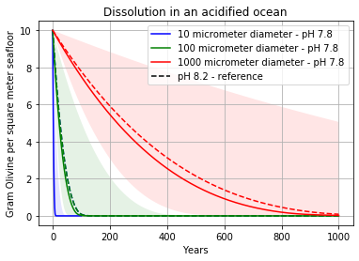
Model results – Olivine dissolution in an acidified ocean
The acidification of our oceans has minor effect

Slide 13
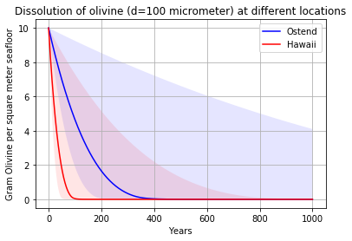
Model results – Deploy in Ostend or Hawaii?
Temperature has large effect as expected
Notes:
Temperature likewise has a large effect, Hawaii looks a lot like the previous 100 mu graph as the temperatures were nearly the same as the one used there.
If we want to use olivine weathering in our coastal systems it seems it is essential that we go to smaller grains sizes than what we would use on Hawaii. However once again before we go fill the coastal zones of Hawaii with olivine a thorough assessment of the emissions regarding “getting” the Olivine there needs to be taken into account!

Slide 14
No model is perfect
Dissolution rates might be faster…
Or might be slower…
Grain is not perfect sphere
Environmental factors:
Biota
Wave action
…
Secondary reactions
Saturation effects
Environmental factors:
Biota
…
Notes:
Couple of big caveats though with this work, obviously it is over simplified. In reality rates might be faster since a grain is not a perfect sphere and thus there is more surface area per volume, also biota and wave action might speed up this process. But it might also be slower due to secondary reactions !!! (it is for example known that a “layer” can develop on the grain which impedes dissolution. An additional note is that all numbers used come from lab experiments!

Slide 15
Summary
Ocean acidification has minor effect
Hawaii is the best place for deployment, but what about transport?
The smaller the grain size the better, but trade-offs…
Big uncertainties regarding true in situ dissolution rates remain!
Notes:
Temperature likewise has a large effect, Hawaii looks a lot like the previous 100 mu graph as the temperatures were nearly the same as the one used there.
If we want to use olivine weathering in our coastal systems it seems it is essential that we go to smaller grains sizes than what we would use on Hawaii. However once again before we go fill the coastal zones of Hawaii with olivine a thorough assessment of the emissions regarding “getting” the Olivine there needs to be taken into account!

Slide 16
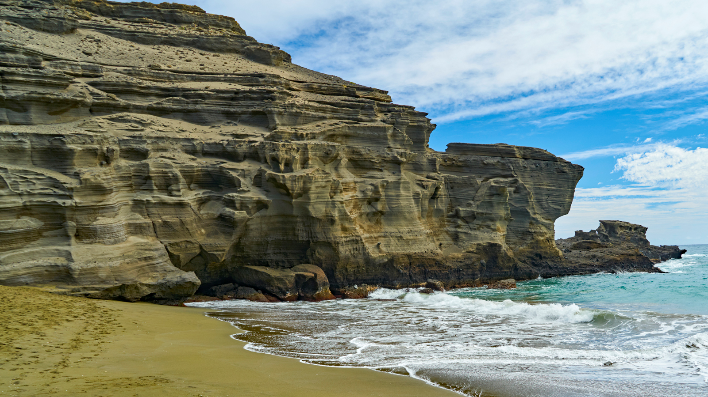
Thank you for listening!

